Slide 1
Samsung
Innovation
Campus
Artificial Intelligence Course

Slide 2



E-Shop Clothing
Ahmed Saed
Mohamed Elsafty
Mostafa Sayed
Supervised by:
Eng. Mohamed Abdullah
Dr. Doaa Mahmoud
Data:
E-Shop Clothing

Slide 3
Agenda
Data Explanation
The Objectives
Data Preparation
Exploratory Data Analysis
Business solutions and recommendations
Data Preprocessing
The Challenges
Modelling

Slide 4
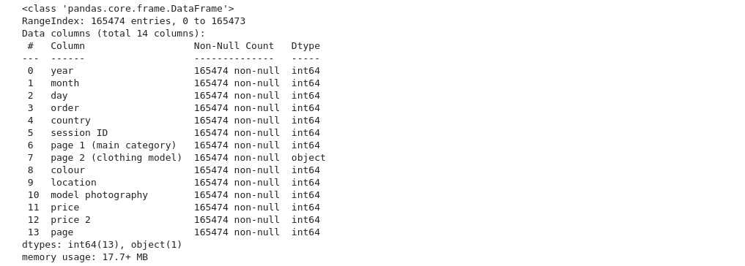
Data Explanation

Slide 5
The Goal
Our main goal is to provide better services for our customers by understanding their needs and improving the business logic
We aim to reach maximum customers at the right time to increase sales and profitability of the business

Slide 6

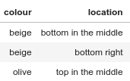
Data Preparation
We mapped the labeled data to its respective values to make it easier for EDA
There were no duplicates or missing values in the data
We removed useless features like ‘session ID’
We didn’t remove any outliers as most of our features are categorical and for the numerical features the outliers seems to be important data.
Before
After

Slide 7
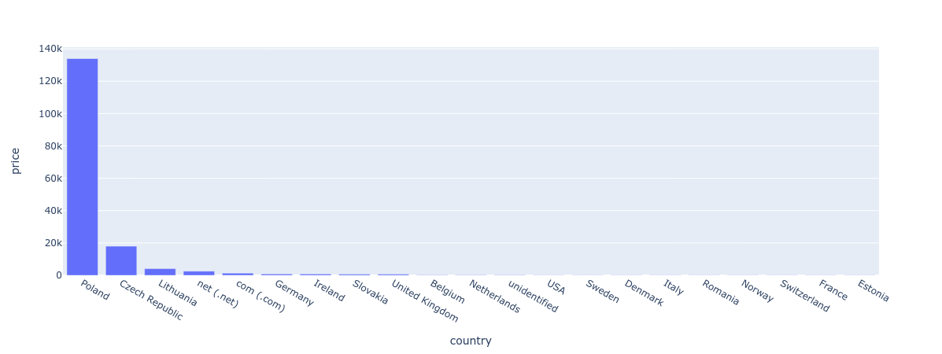
Exploratory Data Analysis
Which country has the most website visitors?

Slide 8
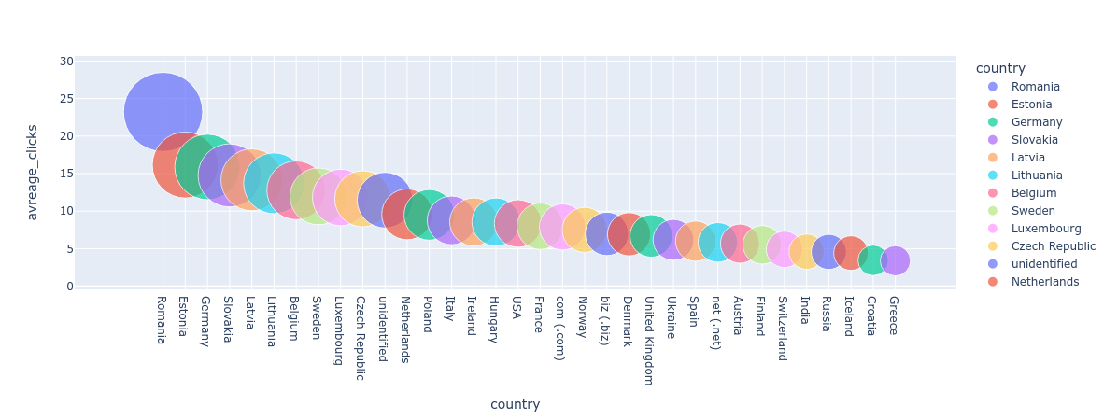
Exploratory Data Analysis
Esability in buying products for each country

Slide 9
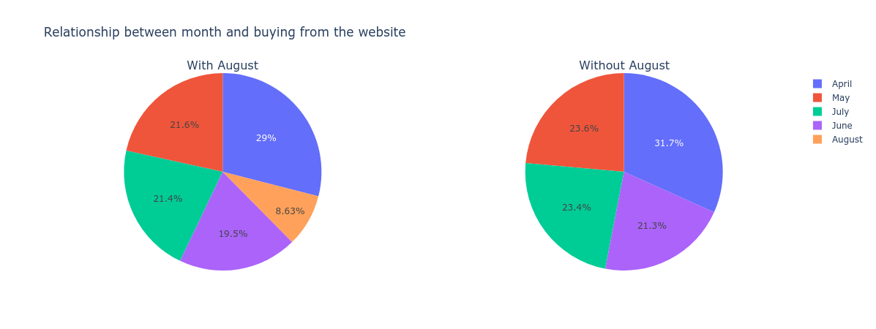
Exploratory Data Analysis
Relationship between months and buying from the website

Slide 10
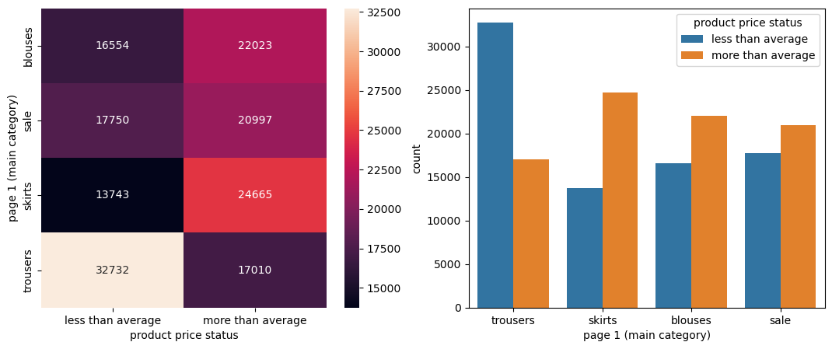
Exploratory Data Analysis
Does users seek cheaper products?

Slide 11
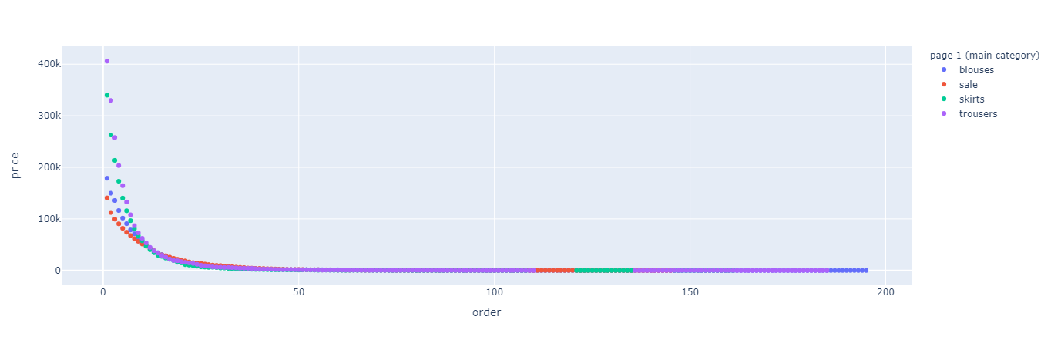
Exploratory Data Analysis
Are more clicks on the website refer to higher profit? and is the main category related? related?

Slide 12
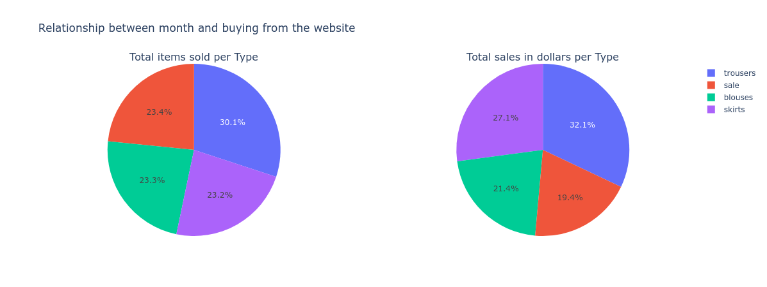
Exploratory Data Analysis
What is the best selling category?

Slide 13
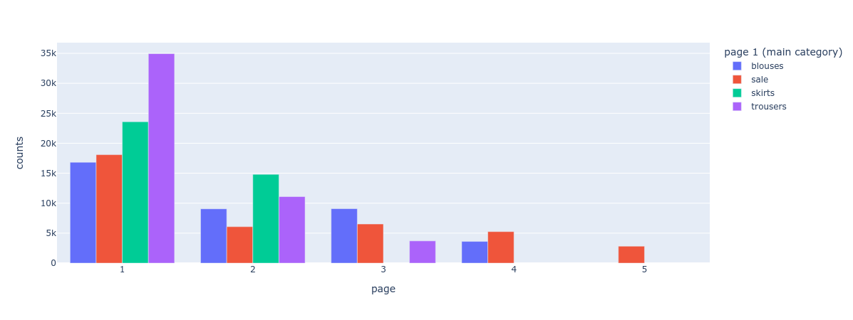
Exploratory Data Analysis
What does customers buy from each page?

Slide 14
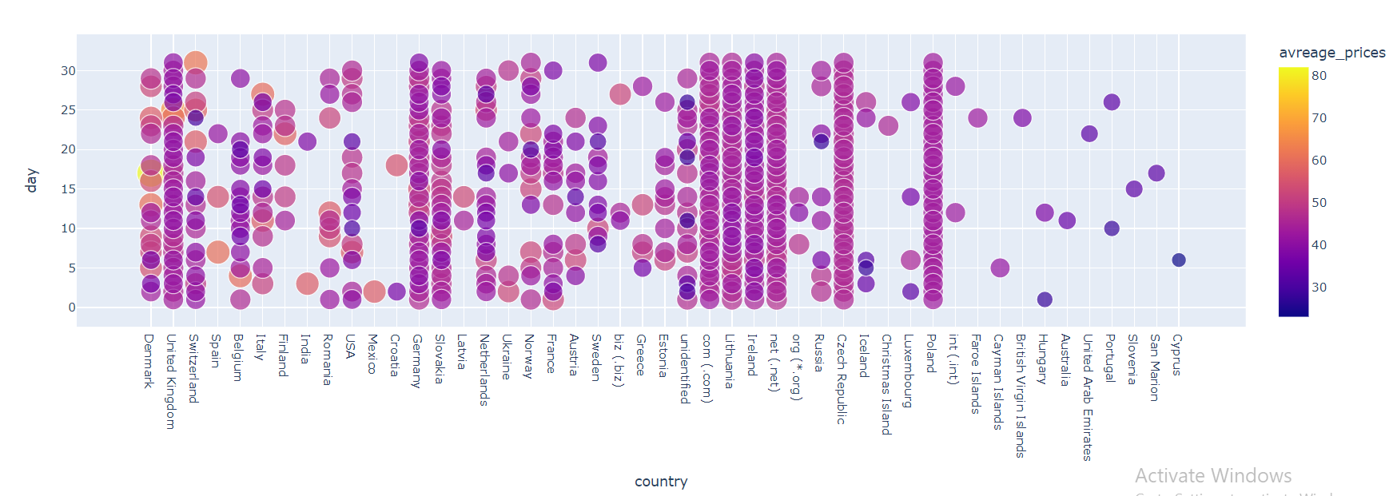
Exploratory Data Analysis
Relation between countries and buying days

Slide 15
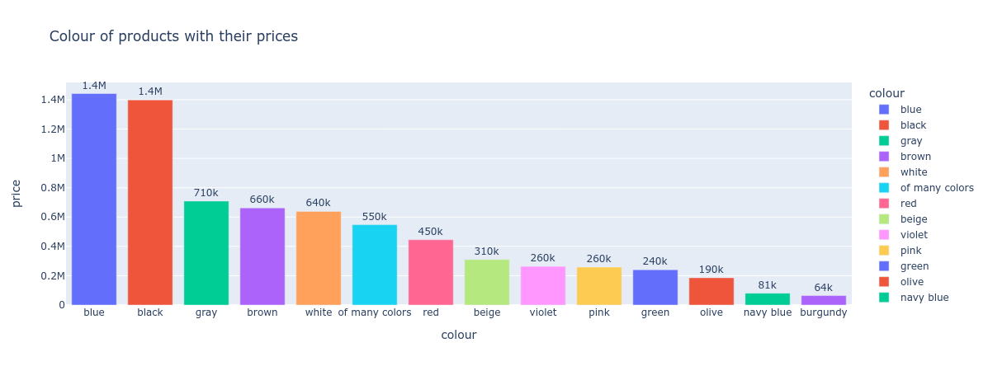
Exploratory Data Analysis
Are selling products affected by color?

Slide 16
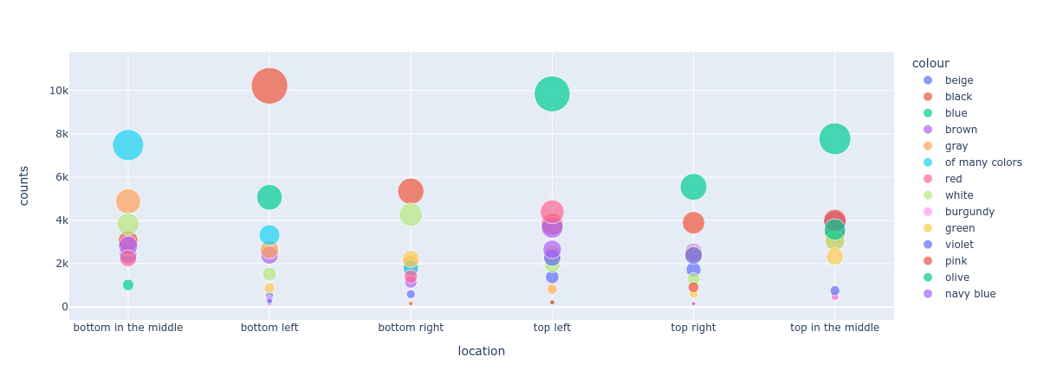
Exploratory Data Analysis
What is the most attractable section in a page and color of product per type?

Slide 17
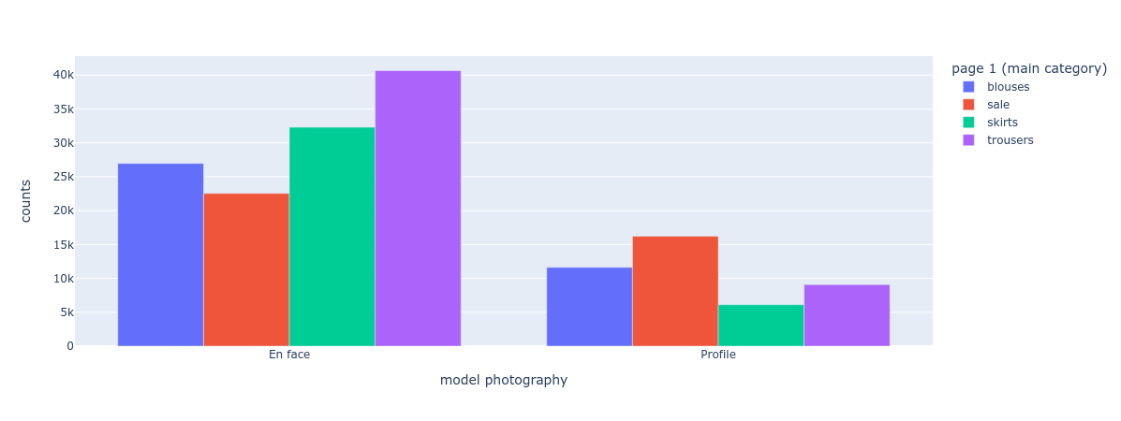
Exploratory Data Analysis
Should we use en face or profile in model photography?

Slide 18
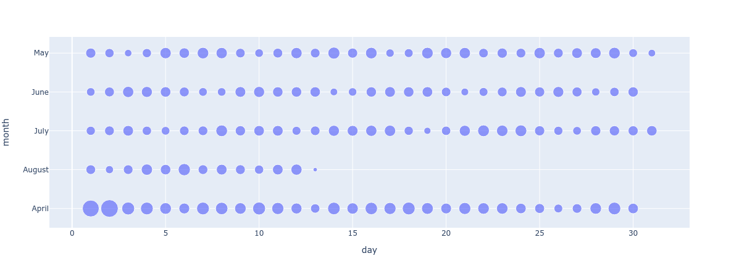
Exploratory Data Analysis
Relation between days and months in sales

Slide 19
Business solutions and recommendations
1. Taking advantage of locations like bottom left with black color and top left with blue color
2. Applying Marketing tools for countries that selling products is constant in the first half of the month
3. Preferring model photography in face of the products to inside the profile as much as possible

Slide 20
Business solutions and recommendations
4. Paying more attention to our prefered countries such as poland and czech republic through their cultures and ceremonies by offering cultural kinds of products and making high sales in their ceremonies.
5. Attracting medium-buying countries such as Germany and Ireland by sales, coupons, dropshipping, ...
6. Putting best selling products in first and second pages and adding adds to these pages

Slide 21
Business solutions and recommendations
7. FaaS (Fulfillment as a Service). We can store your products in our warehouses pick & pack them once orders flow, and ship them with the best, most reliable couriers available per region or country.
8. Full Product and Category Management: Create detailed product pages and organize all your products as you see fit, with robust categorization.
9. Full Suite of Marketing and SEO tools, so you can reach new customers and keep them coming back.

Slide 22
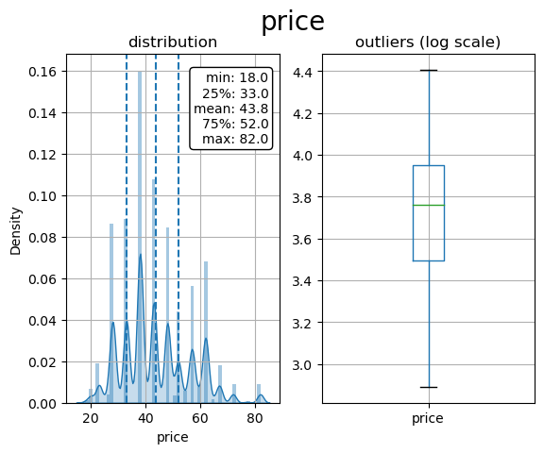
Data Preprocessing - Data Distribution

Slide 23
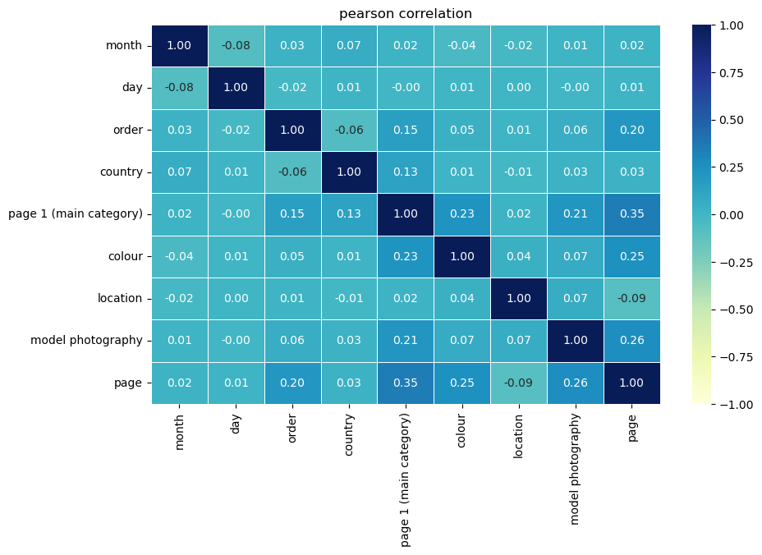
Data Preprocessing - Correlation

Slide 24
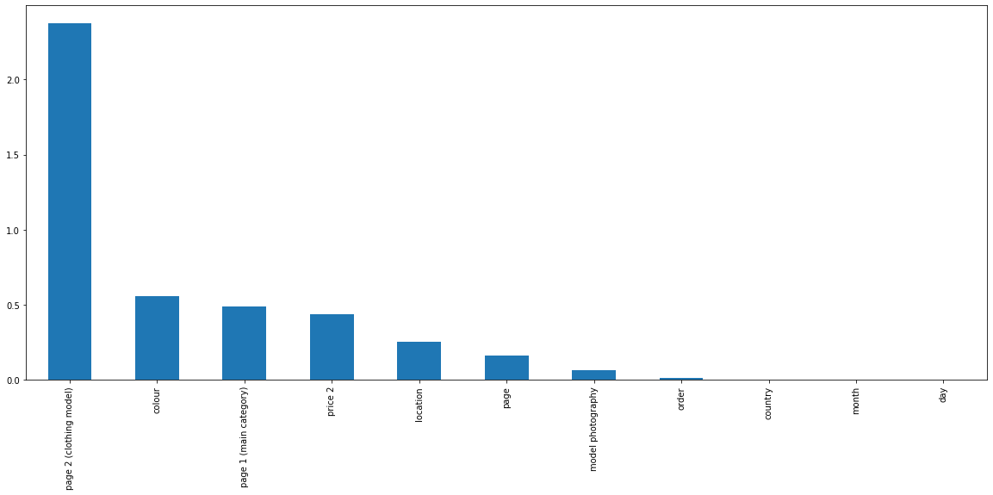
Data Preprocessing - Feature Engineering
Selected Features:
Page 2
color
page 1
price 2
location
page
Page 1: Product category Price 2: Price status
Page 2: Product model

Slide 25
Data Preprocessing - Other preprocessing
We also applied label encoding for ‘page 2 (clothing model)
We scaled the trained data using Standard Scaler
We split the data into train and test datasets with ratio 70:30

Slide 26
The Challenges
Regression on ‘price’ to predict the price of a product
Classification on ‘price 2’ to identify if a product is above the average category price or not

Slide 27
Regression Challenge
We used these models:
1. Linear regression
2. Ridge regression
3. Lasso regression
4. Random Forest Regressor
5. Gradient Boosting Regressor

Slide 28
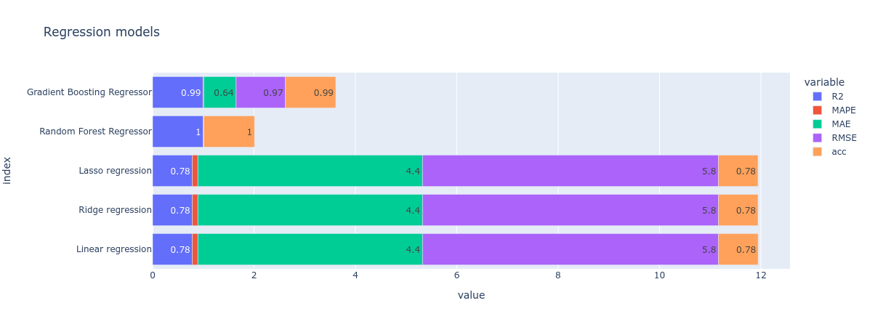
Regression Challenge
We achieved these results:
Based on the results, GB and RF are the best regression models for this challenge

Slide 29
Classification Challenge
We used these models:
1. K Nearest Neighbours
2. Decision Tree
3. Naive Bayes
4. Random Forest Classifier
5. Logistic Regression
6. Support Vector Machine
We applied this preprocessing:
We used K-Fold Cross validation to ensure that every observation from the original dataset has the chance of appearing in training and test set.
We used Hyperparameter Tuning (GridSearch) to choose best parameters for our models

Slide 30
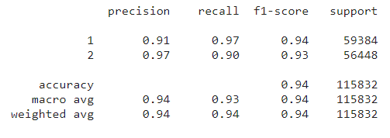
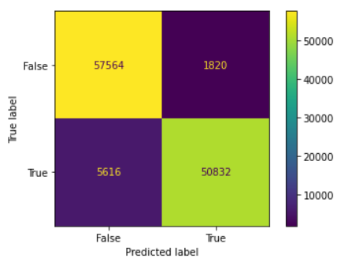
We achieved these results:
Based on the results, KNN are the best classification model for this challenge

Slide 31
Special Thanks for:
Dr. Doaa Mahmoud
Eng. Mohamed Abdullah

